Slide 1
Alternative Alignments from Comparison of Protein Structures
Edward S.C. Shih and Ming-Jing Hwang
PROTEINS:Structure,Function, and Bioinformatics, Vol. 56, pp 519-527,2004
Created by: Chia-Chang Wang
Date: Sept. 30,2004

Slide 2
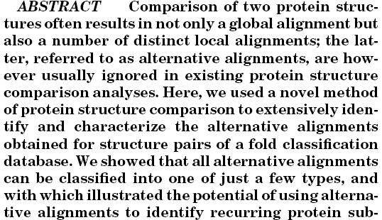
Abstract

Slide 3
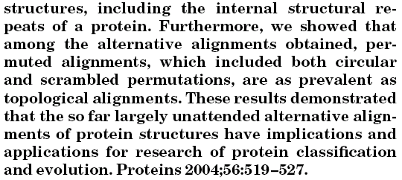
Abstract(cont.)

Slide 4
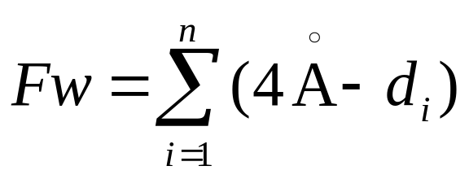
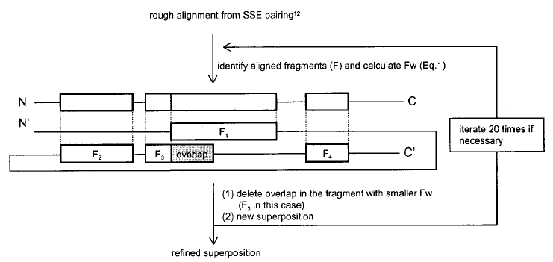
Method

Slide 5
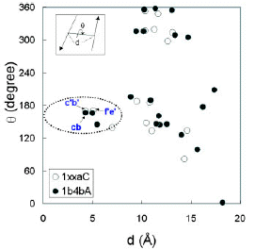
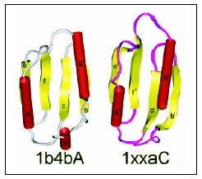
Methods
The angle-distance map of SSE pairs –
a 2D reduction of the 3D structure

Slide 6
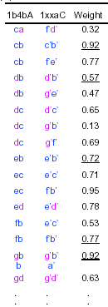
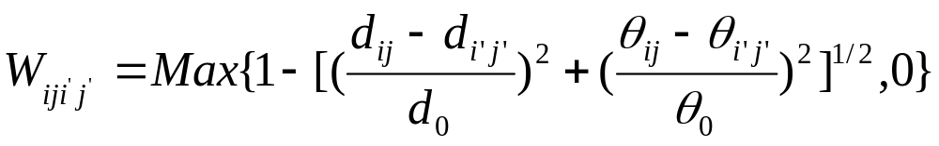
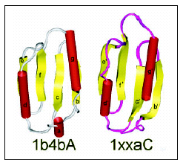
Methods(cont.)
The SSE matching probabilites
d₀ :the threshold value of the midpoint distance
θ₀ :torsion angle

Slide 7
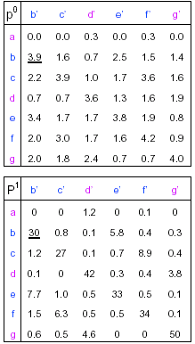
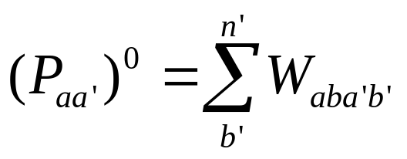
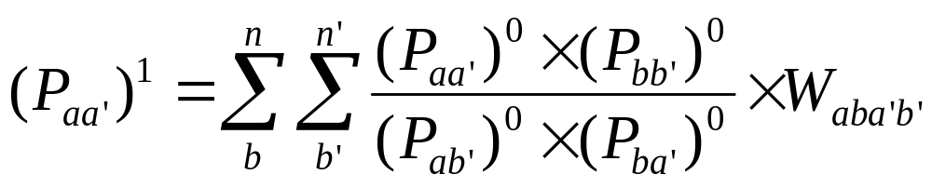
Methods(cont.)
To derive individual SSE
matching probabilities,the
probability weights for SSEs
pairs calculated were combined.

Slide 8
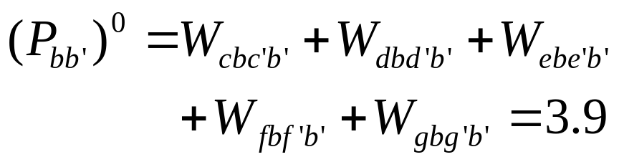
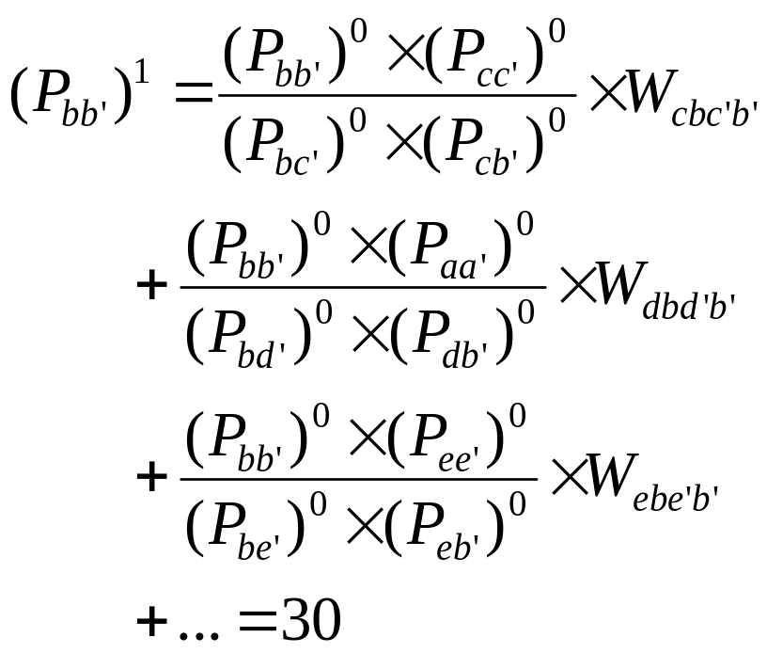

Slide 9
Methods(cont.)
A greedy procedure for selecting viable alignment solutions
  The new match did not contain an SSE that had already been selected
  The new match must fit the constraints of a sequential relationship with matches already selected
  All the recombined inter-SSE pairs generated by the new match must have a non-zero probability weight

Slide 10
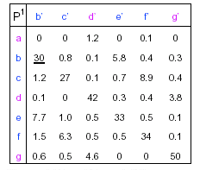
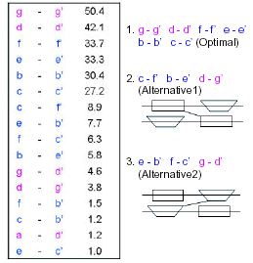
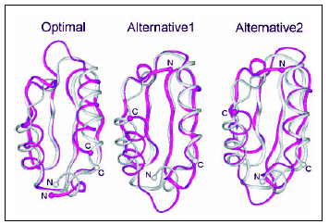
Methods(cont.)
a b c d e f g
a’ b’ c’ d’ e’ f’ g’

Slide 11
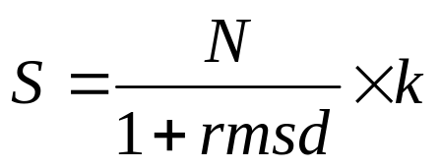
Methods(cont.)
From rough alignment to refined alignment
S : similarity measure
N :number of aligned SSE pairs
k :fitness measure to account for length difference in matched SSEs

Slide 12
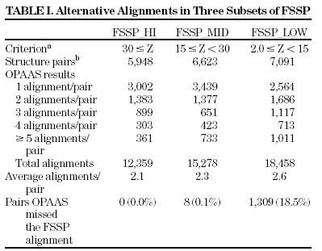
Results

Slide 13
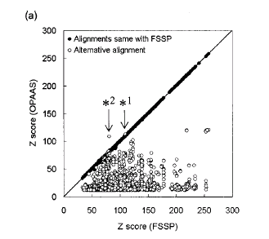
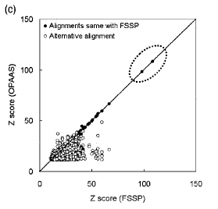
Results(cont.)

Slide 14
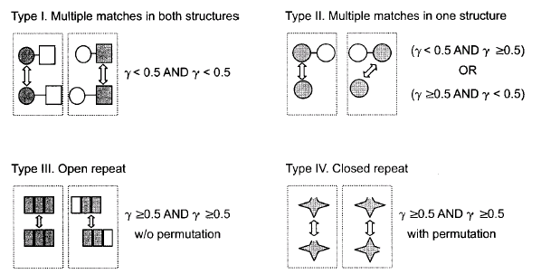
Results(cont.)
r:overlap ratio r’:equivalent ratio

Slide 15
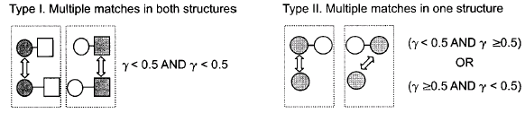
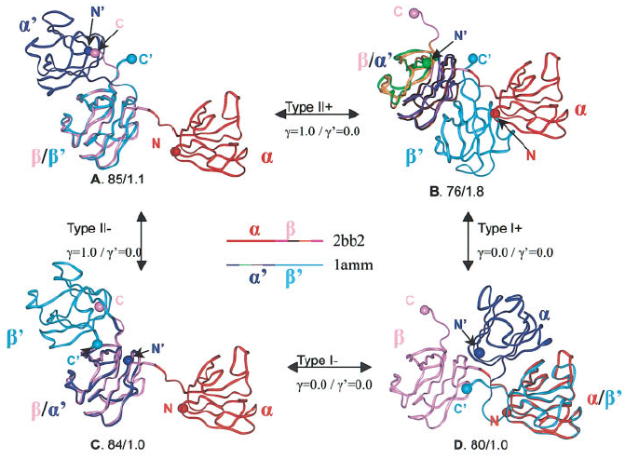
Results(cont.)

Slide 16
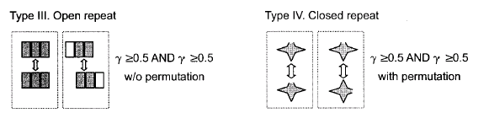
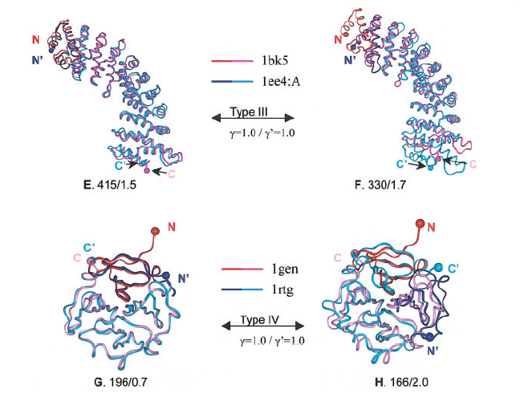
Results(cont.)

Slide 17
END

